Slide 1
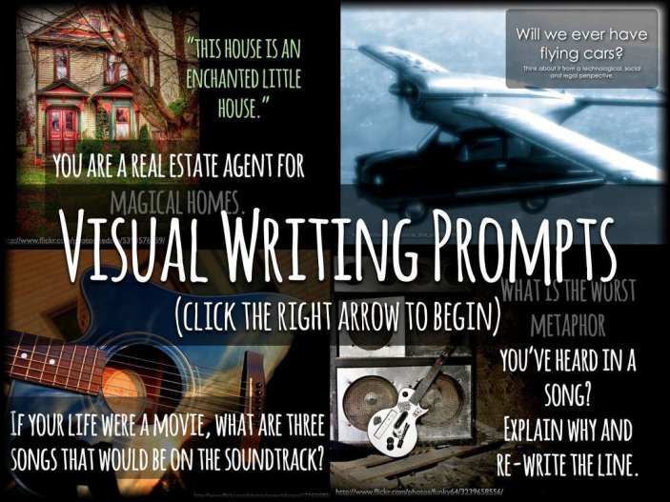
Visual Literacy
http://visualprompts.weebly.com

